Slide 1

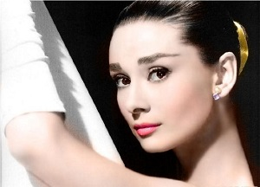
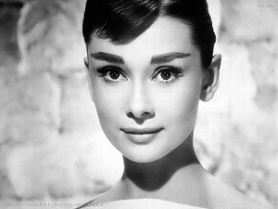
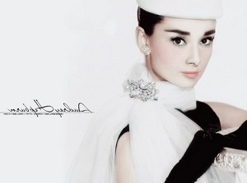
3
Unit 3 Section A
Audrey Hepburn
― A true angel in this world
FOREIGN LANGUAGE TEACHING AND RESEARCH PRESS
AIR FORCE ENGINEERING UNIVERSITY
FOREIGH LANGUAGE TEACHING AND RESEARCH PRESS
AIR FORCE ENGINEERING UNIVERTISY
Notes:
1

Slide 2

Language focus
Practical phrases
Practical Phrases | Specific Meanings
1. be afflicted by | 受…痛苦；受…折磨
2. transform sb./sth. from… to… | 把某人/物从…转变成…
3. embark on/upon | 开始，着手
4. deprive sb. of sth. | 剥夺某人某物
5. be drowned in | 埋头于；沉溺于
6. share in | 分享；分担；参与
7. lead by example | 以身作则
8. be stricken by | 遭受…不幸

Slide 3

Language focus
Practical phrases
受…痛苦；
受…折磨
短语逆译
be afflicted by
短语应用
由于遭受无休止战争的折磨，人们生活在极度贫困之中。
意群提示
(be afflicted by / endless war / extreme poverty)
Afflicted by the endless war, people live in extreme poverty.

Slide 4
Language focus
Practical phrases
把某人/物从…转变成…
transform sb./sth. from… to…
短语逆译
短语应用
军训使他们从普通地方青年转变成合格的军校学员。
意群提示
(military training/ civilian youth/ transform / cadet)
The military training transformed them from ordinary civilian youths to qualified cadets.

Slide 5
Language focus
Practical phrases
开始，着手
短语逆译
embark on/upon
短语应用
带着巨大的决心与勇气，他开始了独自横渡太平洋的航行。
意群提示
(tremendous/ determination / embark on/ solo /voyage)
With tremendous determination and courage, he embarked on a solo voyage across the Pacific Ocean.

Slide 6
Language focus
Practical phrases
剥夺某人某物
短语逆译
deprive sb. of sth.
短语应用
由于贫困，许多偏远地区的儿童被剥夺了受教育的权利。
意群提示
(remote areas / deprive… of… /right to education)
Because of poverty, many children in remote areas are deprived of their right to education.

Slide 7
Language focus
Practical phrases
埋头于；沉溺于
短语逆译
be drowned in
短语应用
这个孩子沉浸在侦探小说引人入胜的情节里，废寝忘食。
意群提示
(be drowned in / detective story / appealing plots / neglect one’s meals and sleep)
Drowned in the appealing plots of the detective story, the child neglected his meals and sleep.

Slide 8
Language focus
Practical phrases
分享；分担；参与
短语逆译
share in
短语应用
所有人，不管是男性还是女性，年老还是年轻，富有还是贫穷，都应参与到构建和谐社会的共同任务中。
意群提示
(share in / common task / harmonious society)
All people, whether they are male or female, old or young, rich or poor, should share in the common task of creating a harmonious society.

Slide 9
Language focus
Practical phrases
以身作则
短语逆译
lead by example
短语应用
好老师会以身作则而不只是口头上告诉学生该做什么。
意群提示
(lead by example/ rather than)
Good teachers lead by example rather than only tell the students what to do.

Slide 10
Language focus
Practical phrases
遭受…不幸
短语逆译
be stricken by
短语应用
2015年4月25日，尼泊尔遭受了8.1级大地震的袭击。
意群提示
(be stricken by / massive earthquake / magnitude)
Nepal was stricken by a massive earthquake with a magnitude of 8.1 on April 25, 2015.

Slide 11
Language focus
Functional patterns
Functional Patterns | Functions & Usages
1. Despite ..., sth. that sb. most prefers doing is (not)… | 用于表达“与表面现象或人们预期相反的情况”。
2. As…, sb. is aware of/knows… | 用于表达“某人在特定身份下，对事物的洞察”。
3. Sb. who would become … began as a … | 用于表达“某人发展道路的开端”。
Notes:
11

Slide 12
Language focus
Functional patterns
原句译文
尽管在电影界获得成功，但她最愿意塑造的角色却并不在影片中。
逆译练习
Despite her success in the film domain, the roles she most preferred portraying were not in movies. (Para 2, L1)
句型提炼
Notes:
12

Slide 13

Language focus
Functional patterns
句型提炼
Despite ..., sth. that sb. most prefers doing is (not)…
应用提示
用于表达“与表面现象或人们预期相反的情况”。
句型应用
Notes:
13

Slide 14
Language focus
Functional patterns
典型例句
尽管他在商界很成功，但他最想追求的目标是成为美声歌唱家。
意群提示
(business field / pursue / bel canto singer)
Despite his success in business field, the goal he most prefers pursuing is to become a bel canto singer.

Slide 15
Language focus
Functional patterns
原句译文
作为一名在纳粹占领下的祖国荷兰生活的小女孩，奥黛丽·赫本清楚战争所带来的野蛮、死亡和破坏。
逆译练习
As a young girl during the Nazi occupation of her native Holland, Audrey Hepburn was aware of the brutality, death, and destruction of war. (Para. 3, L1)
句型提炼
Notes:
15

Slide 16
Language focus
Functional patterns
句型提炼
As…, sb. is aware of/knows…
应用提示
用于表达“某人在特定身份下，对事物的洞察”。
句型应用
Notes:
16

Slide 17
Language focus
Functional patterns
典型例句
作为临床经验丰富的医生，他很清楚病人的最佳治疗方案。
意群提示
(clinical experience/ treatment )
As a doctor with rich clinical experience, he is aware of the best treatment for the patient.

Slide 18
Language focus
Functional patterns
原句译文
这个日后将成为世界上最具魅力女星的小女孩刚开始只是一个无名难民，直面生命中的恐惧和脆弱。
逆译练习
The little girl who would become the world’s most magical actress began as an
anonymous refugee confronting life’s horrors and fragility firsthand. (Para. 4, L1)
句型提炼
Notes:
18

Slide 19
Language focus
Functional patterns
句型提炼
Sb. who would become … began as a …
应用提示
用于表达“某人发展道路的开端”。
句型应用
Notes:
19

Slide 20
Language focus
Functional patterns
典型例句
这个日后将成为世界知名亿万富翁的年轻人刚开始只是一个没有固定收入的小商贩。
意群提示
(billionaire / stable income/ peddler)
The young man who would become the world famous billionaire began as a peddler without stable income.

Slide 21


Language focus
Language appreciation
她经历了两次离婚，并忍受着战争记忆带给她的悲伤，然而，奥黛丽从不让这些悲伤支配自己，或者影响自己对美好未来的向往。
a. She suffered through two divorces and from her memories of the war. Yet, Audrey never let her sadness overcome her or jeopardize her hope for a brighter future. (Para.6, L10)

Slide 22
Language focus
Language appreciation
b. From Bangladesh, … to Somalia, Audrey Hepburn traveled representing UNICEF, making over 50 emotionally draining and physically dangerous missions into bleak destinations to raise world awareness of wars and droughts. (Para.10, L5)
从孟加拉国……到索马里，奥黛丽·赫本代表联合国儿童基金会四处奔走，承担了五十多项劳心劳力、危及生命安全的任务，深入到荒凉之地，唤起世界人民对战争和旱灾的关注。

Slide 23
Language focus
Language appreciation
奥黛丽觉得，太多的儿童被剥夺了简单的快乐而陷入无边的痛苦之中，这是一种罪恶。
c. Audrey felt it was wicked that billions of children were deprived of simple joys and drowned in overwhelming misery. (Para.11, L1)

Slide 24
Language focus
Language appreciation
即使在她63岁生命终止的时候，她仍然充满着关爱，永远象征着纯朴、仁爱、魅力和善良。
d. Even as her life ended at 63 years of age, she remained a gracious woman who perpetually signified simplicity, charity, charm and kindness.(Para.14, L1)

Slide 25

Language focus
Language appreciation
“要想有美丽双眸，就要善于发现他人优点；要想双唇动人，只说和善之辞；要想镇定自信，谨记自己始终与大家同行。”
e. “For beautiful eyes, look for the good in others; for beautiful lips, speak only words of kindness; and for poise, walk with the knowledge that you are never alone.” (Para.15, L4)

Slide 26

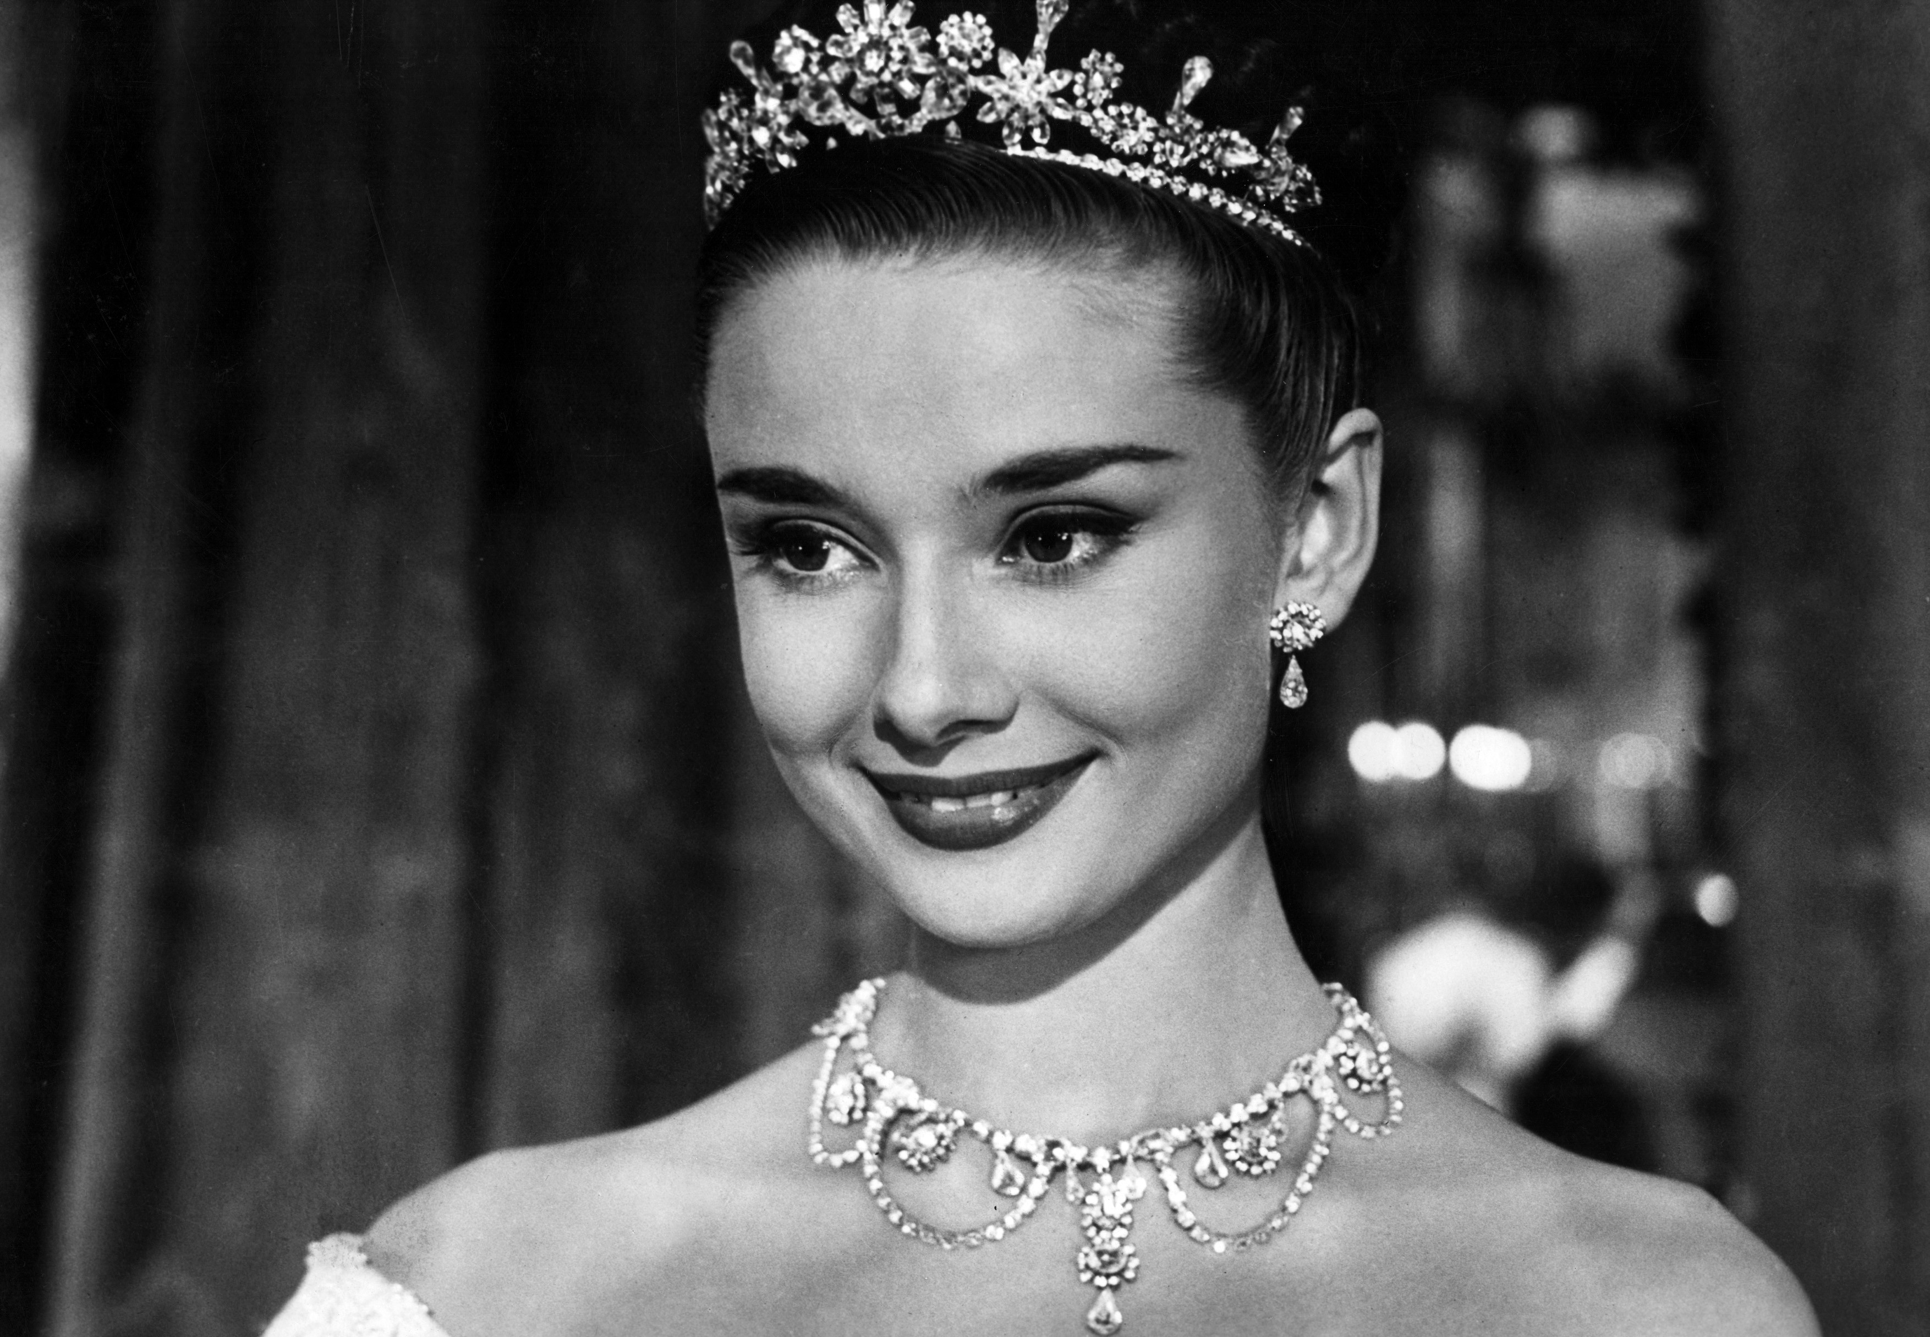
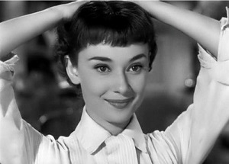
Section A
Audrey Hepburn – A true angel in this world
The end

